Slide 1
Pistol Shrimp Financial
Evan, Ramatu, Emily, Alice (Wanjuan), Melody

Slide 2



Portfolio
EL
EA
ENPH
Estee Lauder companies Inc.
Electronic Arts Inc
Enphase Energy Inc
Cosmetic Industry
Video Game Industry
Solar Energy Industry

Slide 3

Fundamental Analysis
Environmental Analysis (PESTLE)
Company/Financial Analysis
Stock Valuation
Industry Analysis

Slide 4
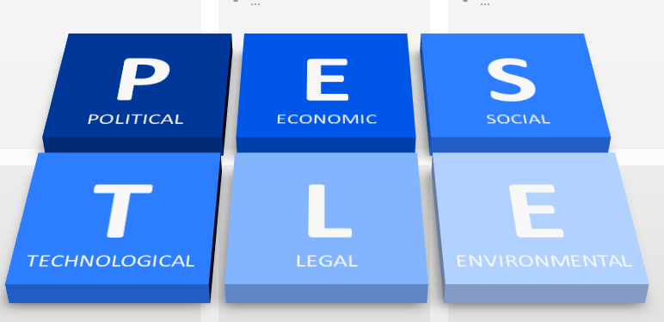
POLITICAL
Taxation: EA, EL and ENPH pay corporate tax to the government in the respective countries they operate in
Pricing regulations so that companies can trade fairly
Trading policies are put in place to liberalize international trade.
OPEC and Russia agreed on oil production cut to avoid further drop in oil prices, mid March into April, Oil prices plummeted globally

Slide 5
ECONOMICAL
Current global economic crisis caused by COVID-19 saw companies shutting down and downsizing
Gaming industry over the last month have seen an increase in sales, lockdown saw EA sales spiking. People in isolation are resorting to games
Globalization has an impact on financial side of a business, exchange rate vary depending on currency being used . EA, EL and ENPH operate in several geographic markets

Slide 6
SOCIAL
Population employment patterns affects businesses globally.
Attitudes-environmental consciousness, use of biodegradable raw materials
Cultural differences
Demographics of the population - Canada has an aging population so companies will soon be short of labor

Slide 7
TECHNOLOGICAL
Degree of automation
Impact of emerging technology has rendered other processes and products obsolete. Gaming industry affected
Companies investing in R&D, as technology is ever evolving
Online sales, EA gaming company leverages on internet

Slide 8
LEGAL
Consumer protection laws, vary by country EA, EL and ENPH should abide by the laws
Employment law intermediate between employees, associations and government. Corporates should abide
Intellectual and patent law are of great importance for any business which wants to protect its methods., EA suffers from piracy

Slide 9
ENVIRONMENTAL
Renewable energy, ENPH is leveraging on that and is in solar energy industry, leading producer of micro-inverters
Green or ecological products to save the ozone layer, reduce carbon emission and reduce global warming

Slide 10
INDUSTRY ANALYSIS
COSMETICS INDUSTRY (Worth $532 Billion as of 2019)
Trends
Social Media and Partnership
Recession
Lipstick Effect
Targeted Pricing Strategy
Mergers and Acquisitions
Inclusivity
Key Success Factors
Brand Image
Social Media and Technology
Pricing and ingredient transparency
Marketing,
Positioning
Product Quality and Availability across all distribution channels.

Slide 11
INDUSTRY ANALYSIS
VIDEO GAME INDUSTRY (Growth est. of $300 Billion in the next 5 years)
Trends
Free-to-Play-model
Recession
Recession Proof
The emergence of Third-party in-game Items market
During tough economic times, entertainment is valued, and the interactive nature of video gaming makes it a very attractive. (CNET, 2009)
Interaction with other Industries
Strong interaction
Revenue
The full game content monetization covered 61 % of the global revenue of console and PC games.
Media and Entertainment – Social Media
Technological – PCs, Tablets, VRs etc.
Beverage – Energy Drinks, Coffee
· eSports: In 2017 the eSports market generated a revenue of 655 million USD (esportsbets.com, 2018)
· In 2017, 80% of the total video game industry's 66 billion USD revenue was attributed to software sales. (WePC, 2020)
The free-to-play gaming platform accounted for 82 % of the digital game market's revenue (monetization Model). (WePC, 2020)

Slide 12
INDUSTRY ANALYSIS
SOLAR ENERGY INDUSTRY (projected to have a CAGR of 20.5% between 2019 and 2026)
Growth
Anticipated to reach a market value of $223.3 billion by 2026 and was valued at $52.5 Billion in 2018
In 2017, more solar PV capacities were installed globally than any other power generation technology (Solar Power Europe, 2018)
China dominates the market demand with a solar PV capacity of 176,100MW (32.3%) as of 2018. In 2017, the country installed more than half the world's solar capacity in one year (53.3 %)
Between 2007 and 2017, the total solar PV capacity increased by over 4,300% (Solar Power Europe, 2018)

Slide 13
Estée Lauder Companies Inc.
Financial Analysis
Ratios | 2017 | 2018 | 2019
Revenue growth |  | 15.7% | 8.6%
Gross margin | 79.4% | 79.2% | 77.2%
SG&A / sales | 63.2% | 62.5% | 59.6%
Return on assets | 33.9% | 29.5% | 31.5%
Total debt to equity | 0.32 | 0.33 | 0.34
Total debt to assets | 0.53 | 0.48 | 0.46
Current ratio | 3.80 | 3.76 | 2.71
Quick ratio | 2.59 | 2.71 | 1.91
Accounts receivable turnover | 8.48 | 9.50 | 8.96
Inventory turnover | 1.65 | 1.84 | 1.87

Slide 14
Electronic Arts Inc.
Financial Analysis
Ratios | 2017 | 2018 | 2019
Revenue growth |  | 6.3% | -3.9%
Gross margin | 73.2% | 75.2% | 73.3%
SG&A / sales | 23.0% | 21.6% | 23.5%
Return on assets | 12.5% | 12.2% | 11.4%
Total debt to equity | 1.21 | 0.98 | 0.68
Total debt to assets | 0.47 | 0.46 | 0.40
Current ratio | 2.15 | 2.41 | 2.82
Quick ratio | 2.15 | 2.41 | 2.82
Accounts receivable turnover | 13.50 | 13.84 | 9.82
Inventory turnover | - | - | -

Slide 15
Enphase Energy, Inc.
Financial Analysis
Ratios | 2017 | 2018 | 2019
Revenue growth |  | 10.5% | 97.5%
Gross margin | 19.6% | 29.9% | 35.4%
SG&A / sales | 15.8% | 17.8% | 12.1%
Return on assets | -26.7% | -3.4% | 22.6%
Total debt to equity | (0.60) | (0.96) | (2.38)
Total debt to assets | 1.05 | 0.98 | 0.62
Current ratio | 1.42 | 1.51 | 2.51
Quick ratio | 1.14 | 1.40 | 2.34
Accounts receivable turnover | 4.38 | 4.38 | 5.57
Inventory turnover | 8.85 | 10.49 | 16.38

Slide 16
Industry Metrics
Ratios | Electronic Entertainment | Cosmetics | Renewable Energy
Gross margin | 54.2% | 46.0% | 31.5%
Return on assets | 6.630% | 5.6% | 0.3%
Current ratio | 2.43 | 1.88 | 2.66
Collection period for accounts receivable (days) | 54.23 | 86.90 | 41.69
Accounts receivable turnover | 6.73 | 4.2 | 8.755

Slide 17
Company Analysis
Estée Lauder Companies Inc.
Founded in 1946
Manufacture skin care, makeup, fragrance, and hair care products
Owns 25+ brands
Electronic Arts Inc.
Founded in 1982
Mainly develops, designs, and produces different types of games to customers
19 studios around the world to develop, deliver games to the customers
Enphase Energy, Inc.
Founded in 2006
Designs, develops and sells home energy solutions for the solar photovoltaic industry

Slide 18
Estée Lauder Companies Inc.
Strengths Online shops, e-commerce increases sales and global reach. online and travel retail channels, and the Estée Lauder, La Mer and luxury fragrance brands Continued growth worldwide has strengthened Estee Lauder’s position in the cosmetics industry Financial position, strong second quarter, with net sales of 4.62 billion $, up 15% from the same period in the prior year. Company’s strong internal structure Acquisition of South Korean businesses Dr. Jart+ and Do The Right Thing Heavy presence on social media Strong brand name, product portfolio and position, has 25+ prestigious brands | Weakness Dealership-distribution of products through agent channels. EL products can be found in stores like Sephora and Macy’s. EL has heavy reliance on third party distribution Limited product portfolio as compared to competitors in the beauty and cosmetic industries
Opportunity Product expansion, there is potential growth in other products lines offered by competitors such as Procter &Gamble Expansion into new geographic markets, have increased presence in African countries potential investors as that would indicate a solid operations structure within the company. | Threats Competition from big brands like L’Oréal which have better resources to respond to changing macro environment the tariff impacts in China, as well as adverse currency movements may also impact Estee Lauder’s performance in the years to come New entrants into the cosmetics industry, meaning that Estee lauder Counterfeit products

Slide 19
Electronic Arts Inc.
Strength Global market expansion Investment in R & D Offer some free games this increase reach Strong financial position, acquired 2M Soft Inc a gaming company Digital distribution Design games for several platforms including PlayStation and Switch Interactive games with voice commands and coaching Expending its market into mobile gaming | Weakness Release date are specific Gaming production costs are high High production cost of story-based single player games
Opportunity Leveraging on internet -online gaming portal EA also licensed and has rights from sports leagues, player associations, movie studios, and book authors to develop games based on sports franchises, movies, and books Combining virtual reality games with events such as World War II to let generation Z and millennials experience an era that they never experienced before EA agreed to put its games on the Steam platform to allow more potential customers | Threat Rivalry from competitors e.g. Nintendo, Take Two EA’s games are operated on multi-consoles which are from third parties, so the sales are correlated Growing in mobile gaming market is slow Substitute apps ang games on mobile games

Slide 20
Enphase Energy, Inc.
Strength High brand loyalty by high product quality Experienced Management team Enphase Energy makes its product offerings unique, exclusive, and difficult for competitors to emulate Reducing its operational costs Paid off significant debts Increased its production capacity by expanding to Mexico Partnerships between other leading photovoltaic (PV) module producers in the industry (SunPower, Panasonic, Solaria) | Weakness Low production caused by component shortage Troubles to meet increasing demands The decision-making time at Enphase Energy has been taking too much time, causing expensive delays in releases and frustrating customers. Enphase Energy does not have a diverse workforce for Enphase Energy to compete on the global stage, it must contain a workforce composed of culturally intelligent people.
Opportunity Global expansion, into additional geographic markets Product line expansion Eliminate expedite fees to increase gross margin Optimise supply chain Political and ethical shifts toward sustainable business | Threat Increased competition Shortage of shilled labour Changes in regulatory framework and introduction of newer, stricter regulations Growth in the recent expansion to Europe has been disappointing The solar and renewables industry continues to be one of the most volatile

Slide 21
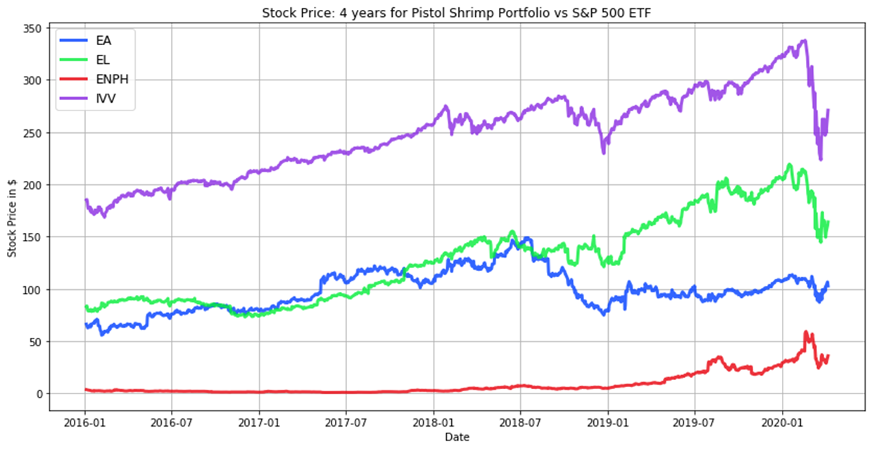
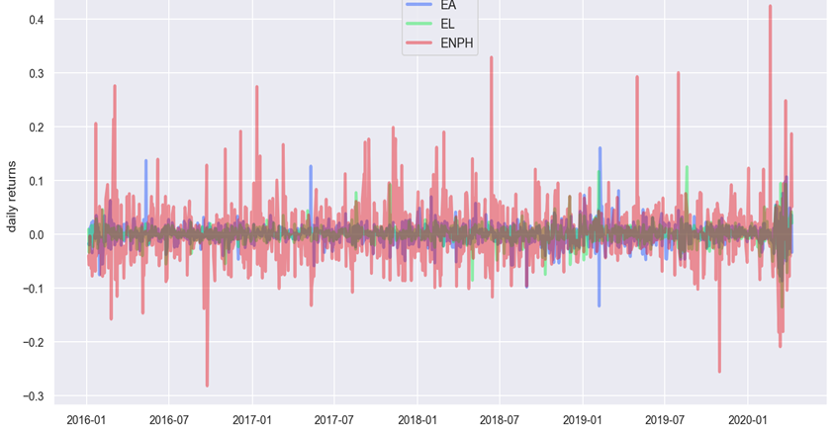
Technical Analysis
2016 – 2020 stock performance for EA, EL, ENPH plotted vs the S&P 500 (IVV)
Daily returns plotted below
ENPH (red) has the most volatility – highest highs and lowest lows

Slide 22
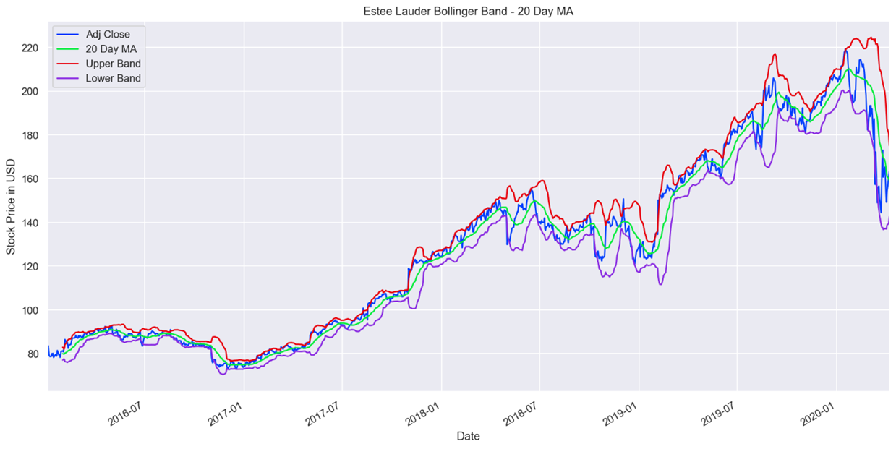
EL
After its 2014 acquisition of Le Labo and January 2015 acquisition of GLAMGLOW, EL continued its spree of acquiring small brands with global appeal in 2016, by integrating By Kilian, a high-end fragrance suite.
EL expanded operating margins and beat analyst expectations for every quarter in 2017: appealing to millennials by hiring social-media-savvy celebrities like Kendall Jenner to promote their products and focusing on fast-growing markets (i.e.. China)
The quarter ending December 2018 reported 17% increase in sales, due in part to the acquisition of 2 new brands Too Faced and Becca acquired in late 2016.
2019 saw incredible growth for EL, with some initial volatility and a dip around August-Sept 2019. The acquisition of Do the Right Thing and Jart+ have buoyed their position within the industry.
Strong 2019 Q4 – up 55% since January -- are due in part to growth in Asia, the popularity of cosmetics in the heightened world of social media such as Instagram, and an ever-growing demand for skincare products.
EL dips after Coronavirus hits, and they must close retail stores. They no longer expect to meet their sales goals.

Slide 23
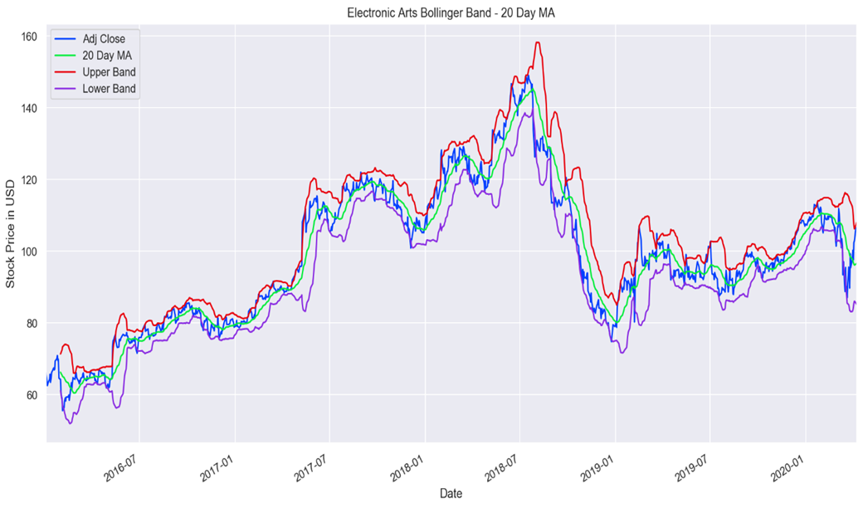
EA
From end of 2013 to July 2018, EA had great performance, seeing its with stock price climbing 461%.
The first half of 2018 saw tremendous momentum for EA, with digital revenue surging 17% over the previous year, driven with strong customer engagement with their flagship sports products, NFL 18 and Madden NFL 18.
3rd quarter of 2018 sudden, steep and sustained decline: delayed Battlefield V until Nov 2018, which ended up flopping and missing holiday sales targets
Competitive market
In 2019, EA reported 3rd quarter net income of $262 million, relative to its 2018 3rd quarter loss of $186 million.

Slide 24
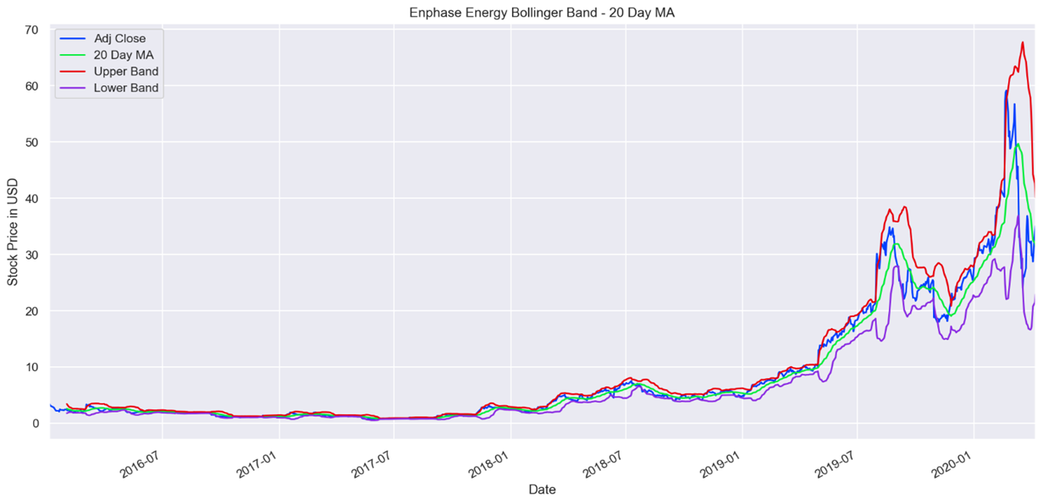
EnpH
Late 2016, ENPH introduced its new energy storage products to the market. Their systems are flexible and can pair with non-Enphase energy storage systems.
Overall growth is a result of the increased demand for their innovation of solar microinverters and higher AC module shipments
ENPH turned profitable in Q4 of 2018. Their new product lineup and latest-generation IQ 7 microinverters revolutionize the industry.
For the first half of 2019, ENPH had massive operating performance, 10X that of 2018: They no longer face competition from Chinese Microinverter company Huawei; this was their 3rd straight profitable quarter.
In May 2019, ENPH announces they will release in mid 2020 their next-gen microinverter, IQ8, a ‘grid-agnostic’ ensemble system.
ENPH stock price plunged last quarter of 2019 since other alternative sources of energy like natural gases went down

Slide 25
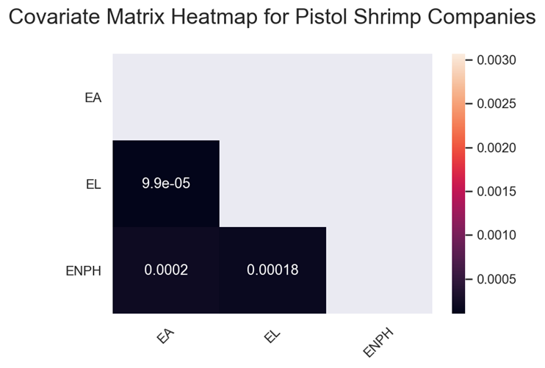
Covariance
Covariance measures the directional relationship between two asset prices.
A positive covariance means that assets generally move in the same direction, whereas negative covariance indicates stocks generally move in opposite directions.
In our portfolio mixture, our assets all have a negligible positive covariance.
EL and EA have the lowest covariance; EL and ENPH have the highest covariance.
MPT aims to create an optimal, diversified mix of higher-volatility assets (such as ENPH) with lower-volatility assets (such as EL). In doing so, we aim to reduce risk and still allow for a positive return.

Slide 26
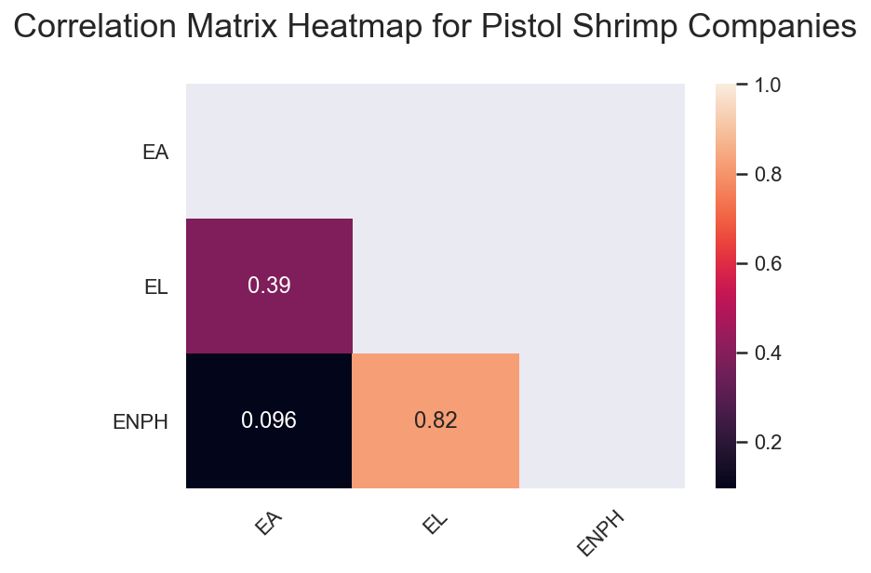
correlation
Covariance measures the direction of the linear relationship between variables, whereas correlation indicates both the strength and direction of the linear relationship between two variables.
All the stocks in our portfolio have a degree of positive correlation.
EL and ENPH are strongly correlated, at 0.82. That is interesting given that they are entirely different industries, gaming and renewable energy.
EL and EA are moderately correlated, at 0.39.
ENPH and EA are very weakly correlated, at 0.096.

Slide 27
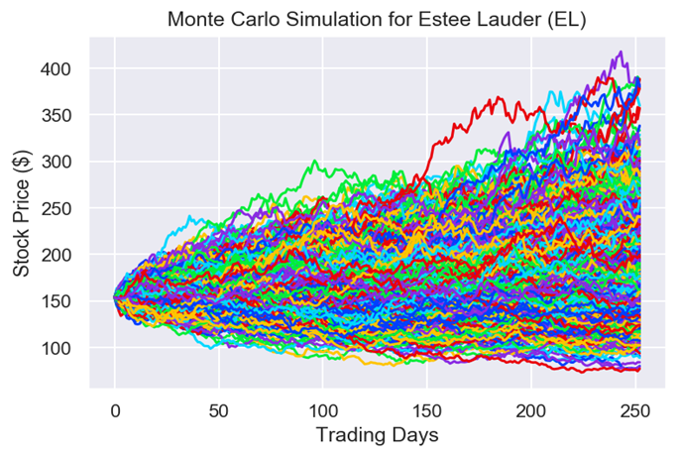
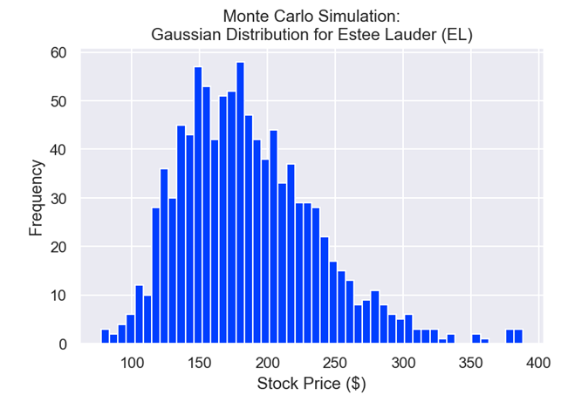
Monte-Carlo simulation: El
EL’s mean yearly simulated return is $199.30, with a standard deviation of $54.42.
Its simulated return is higher than both ENPH and EA, and the standard deviation is right in the middle of those two.
The potential maximum return is $444.20, higher than EA’s maximum but significantly lower than ENPH’s
minimum yearly return, at $76.89, is only slightly lower than ENPH’s mean return, at $75.66.
The median is very close to the mean.

Slide 28
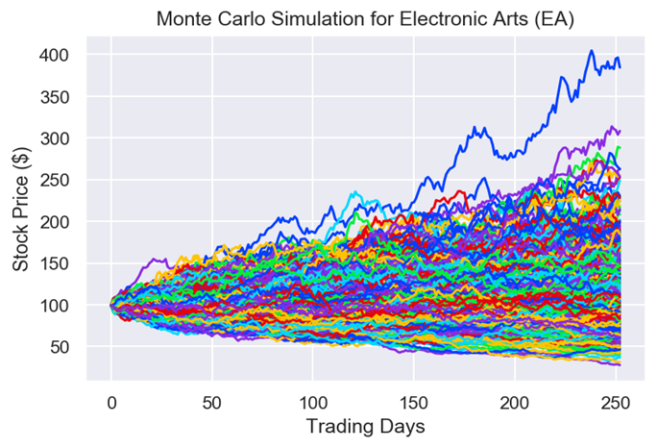
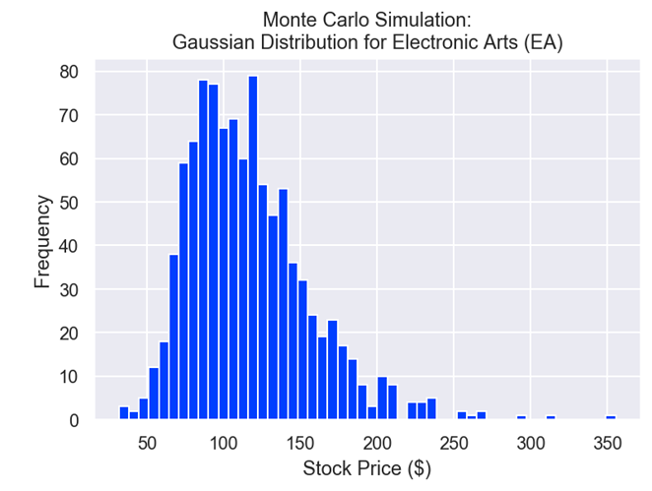
Monte-Carlo simulation: Ea
EA has a mean 1-year return of $119.42, with a standard deviation of $41.35.
Relative to ENPH, the mean return is higher, and the standard deviation is much lower.
The maximum simulated return is also quite a bit lower, at $398.09, but the minimum yearly return is somewhat less egregiously low.
The median return, $113.36, is very close to the mean return.

Slide 29
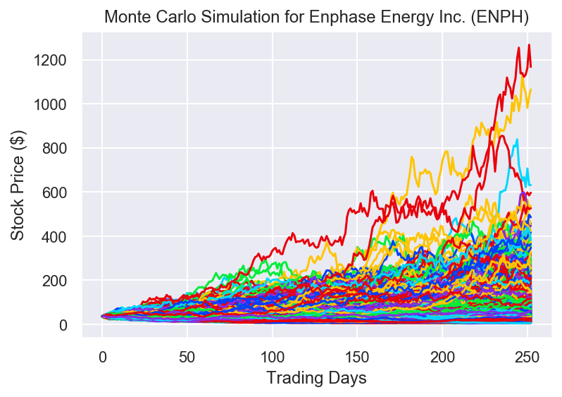
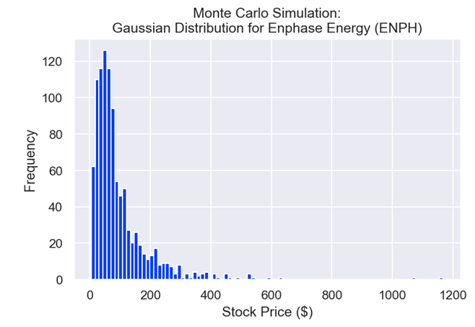
Monte-Carlo simulation: ENPH
ENPH has a high volatility and a high standard deviation ($97.84) relative to the mean ($95.14)
the simulated maximum return is extremely high relative to the minimum, $1,167.12 vs. $4.69.
Surprisingly, the median is quite a bit lower than the median, at $65.98.

Slide 30
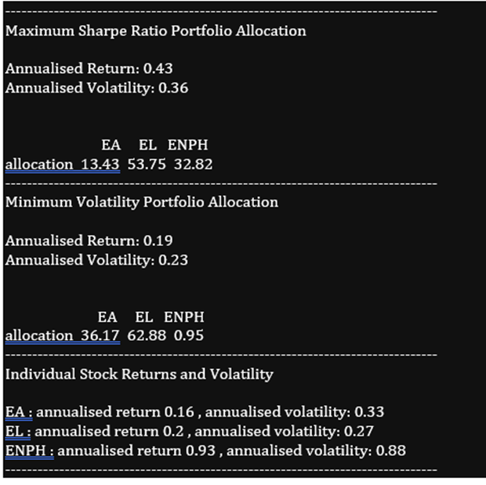
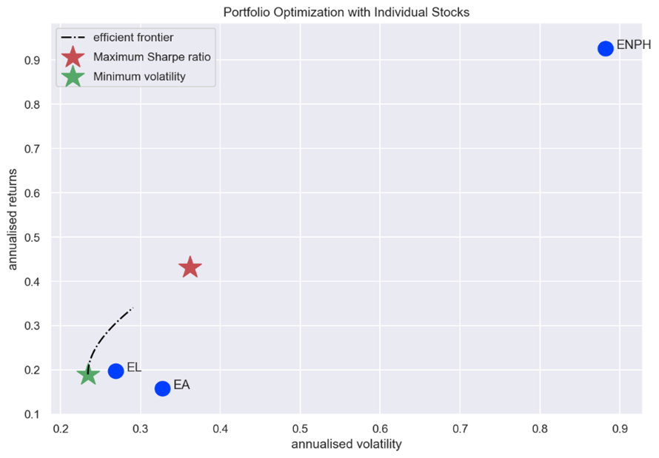
Portfolio Recommendations
We recommend breaking down the $1,000,000 investment :
EA: 13.43%, EL: 53.75%, ENPH: 32.82%.
At worst, a 7% return (43-36).
Compared to US T-Bill (Risk Free Rate): 1.52%
Minimum Expected Return vs RFR: 7-1.52=5.48%
At worst, you make $54,800 with our portfolio.

